Slide 1


Welcome Everyone
GIT
GITHUB

Slide 2

Sahil Ali
Btech CSE Alpha MLSA Google Developer Students Club Lead
Neural Network , Natural Language Processing

Slide 3
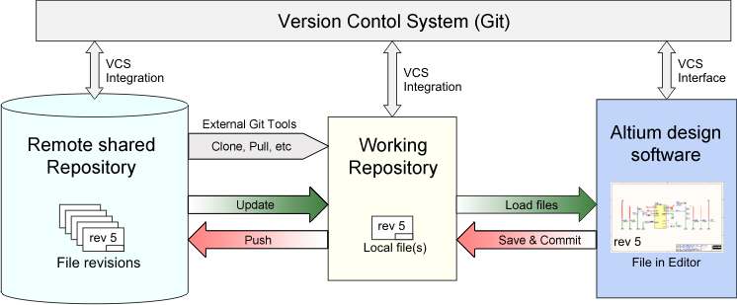
Let’s get started!
What is Version Control?
Version control is a system that records changes to a file or set of files over time so that you can recall specific versions later. So ideally, we can place any file in the computer on version control.
Notes:
Umm… Okay… But Why Tho?
Here’s Why:
A Version Control System (VCS) allows you to revert files back to a previous state, revert the entire project back to a previous state, review changes made over time, see who last modified something that might be causing a problem, who introduced an issue and when, and more. Using a VCS also means that if you screw things up or lose files, you can generally recover easily. And sometimes you just want to know “who wrote this crap”, and having access to that information is worthwhile ?.
Once upon a time, there was a software developer named Julia who was working on a new project. She was making great progress, but she was starting to get worried about losing her work. She knew that if her computer crashed, she would lose everything she had done.
One day, Julia heard about a thing called version control. Version control is a system that keeps track of all the changes you make to your files. This means that even if you accidentally delete or overwrite something, you can always go back to an earlier version.
Julia decided to give version control a try. She installed Git, which is a popular version control system, and created a repository for her project. Every time she made a change to her code, she committed it to the repository. This created a new version of her code, which was stored in the repository.
Now Julia could rest easy knowing that her work was safe. If her computer crashed, she could just restore the latest version of her code from the repository. She could also use version control to collaborate with other developers on her project.

Slide 4
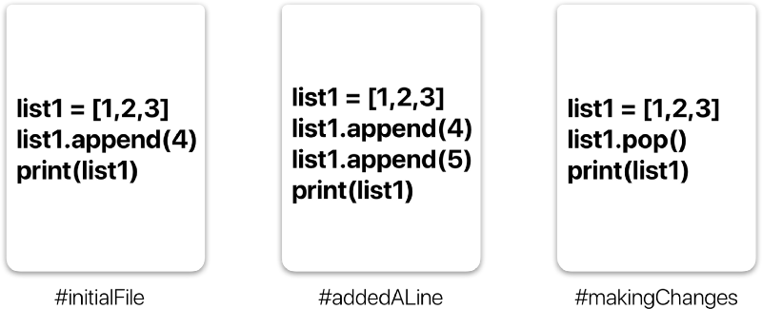
So What is Git?
Git is a free, open-source version control software. This basically means that Git is a content tracker.
So Git can be used to store content — and it is mostly used to store code because of the other
features it provides.
Notes:
Real life projects generally have multiple developers working in parallel. So they need a version control system like Git to make sure that there are no code conflicts between them.
Also, the requirements in such projects change often. So a version control system allows developers to revert and go back to an older version of their code.
In the example above, all three cards represent different versions of the same file. We can select which version of the file we want to use at any point of time. So I can jump to and fro to any version of the file in the git time continuum. So imagine you and your friend are collaborating on a project. You both are working on the same project files. Now Git takes those changes you and your friend made independently and merges them to a single “Master” repository. So by using Git you can ensure you both are working on the most recent version of the repository.

Slide 5
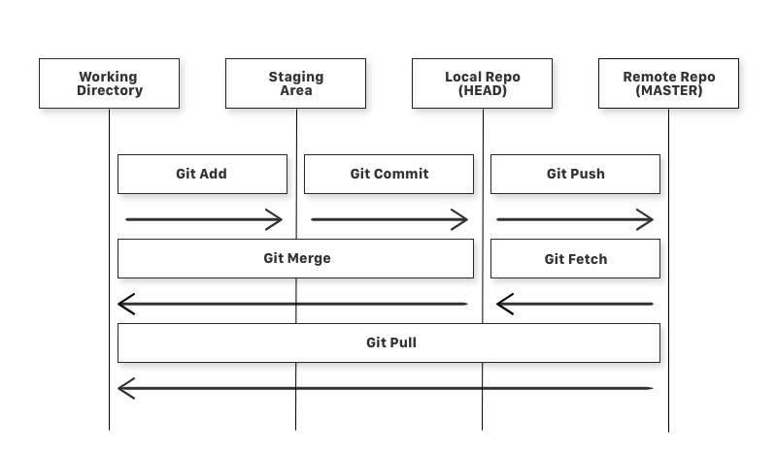
What is a Repository ? A repository a.k.a. repo is nothing but a collection of source code.
There are four fundamental elements in the Git Workflow.
Working Directory,
Staging Area,
Local Repository,
Remote Repository.
Notes:
Before we start working with Git commands, it is necessary that you understand what it represents. If you consider a file in your Working Directory, it can be in three possible states.
It can be staged. Which means the files with the updated changes are marked to be committed to the local repository but not yet committed.
It can be modified. Which means the files with the updated changes are not yet stored in the local repository.
It can be committed. Which means that the changes you made to your file are safely stored in the local repository.
Once upon a time, there was a file named "my-file.txt" in a developer's Working Directory. The file was in the modified state, which means that the developer had made some changes to the file, but the changes had not yet been saved to the local repository.
One day, the developer decided to commit the changes to the file. They used the git add command to stage the changes, which means that they marked the changes to be committed to the local repository.
The file was now in the staged state. This means that the changes were ready to be committed, but they had not yet been saved to the local repository.
The developer then used the git commit command to commit the changes to the local repository. This saved the changes to the file and moved the file to the committed state.
The file was now in the committed state, which means that the changes were safely stored in the local repository. The developer could now be confident that they would not lose their changes if their computer crashed or if they made a mistake.
The three possible states of a file in your Working Directory are:
Modified: The file has been changed, but the changes have not yet been saved to the local repository.
Staged: The changes to the file have been marked to be committed to the local repository, but they have not yet been committed.
Committed: The changes to the file have been saved to the local repository.

Slide 6
GIT Commands
git add
git commit
git push
git fetch
git merge
git pull
Notes:
git add is a command used to add a file that is in the working directory to the staging area.
git commit is a command used to add all files that are staged to the local repository.
git push is a command used to add all committed files in the local repository to the remote repository. So in the remote repository, all files and changes will be visible to anyone with access to the remote repository.
git fetch is a command used to get files from the remote repository to the local repository but not into the working directory.
git merge is a command used to get the files from the local repository into the working directory.
git pull is command used to get files from the remote repository directly into the working directory. It is equivalent to a git fetch and a git merge .

Slide 7

Install Github
To create your account, you need to go to GitHub's website and fill out the registration form.
Notes:
To create your account, you need to go to GitHub's website and fill out the registration form.

Slide 8
Git installation
Now we need to install Git's tools on our computer. We’ll use CLI to communicate with GitHub.
For Ubuntu:
First, update your packages. Sudo apt update
2. Next, install Git and GitHub with apt-get
Sudo apt-get install git
3. Finally, verify that Git is installed correctly
git--version

Slide 9
Git installation
Now we need to install Git's tools on our computer. We’ll use CLI to communicate with GitHub.
For Mac :
Open a Terminal window.
Type the following command and press Enter:
brew install git
3. Verify that Git is installed correctly by typing the following command and pressing Enter:
git --version

Slide 10
Git installation
Now we need to install Git's tools on our computer. We’ll use CLI to communicate with GitHub.
For Windows:
Go to the Git website: https://git-scm.com/download/win and download the installer.
Run the installer and follow the on-screen instructions.
3. Once the installation is complete, verify that Git is installed correctly by opening a Command Prompt window and typing the following command:
git –version
then Press ENTER example : git version 2.36.0.windows.1
Notes:
Now that we know what Git is and it’s basic terminologies, let’s see how we can place a file under git. We’re going to do it the right way and the difficult way. Without any GUI applications.
I’m assuming you already have a file the you want to place under version control. If not create a sample folder named ‘Aditi’ and place some sample code files in it.

Slide 11

Tell Git who you are.
Introduce yourself. Slide in. Seriously, mention your Git username and email address, since every Git commit will use this information to identify you as the author.
$ git config --global user.name "YOUR_USERNAME" $ git config --global user.email “sahil.ali@studentambassadors.com" $ git config --global --list # To check the info you just provided

Slide 12
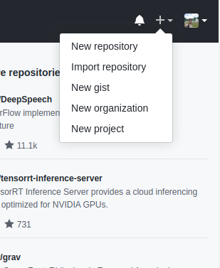
Create the repository, clone it to your PC, and work on it.
Notes:
Creating a totally fresh repository on GitHub, cloning it to our computer, working on our project, and pushing it back.
Create a new repository by clicking the “new repository” button on the GitHub web page.

Slide 13
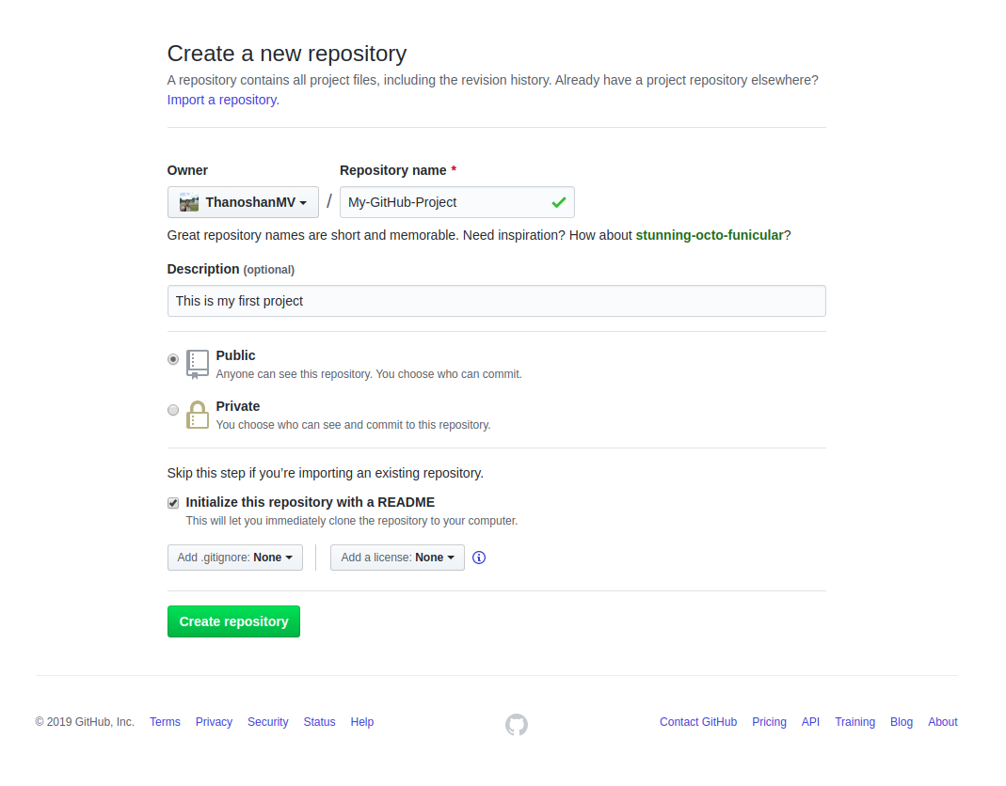

Notes:
Pick a name for your first repository, add a small description, check the ‘Initialize this repository with a README’ box, and click on the “Create repository” button.

Slide 14
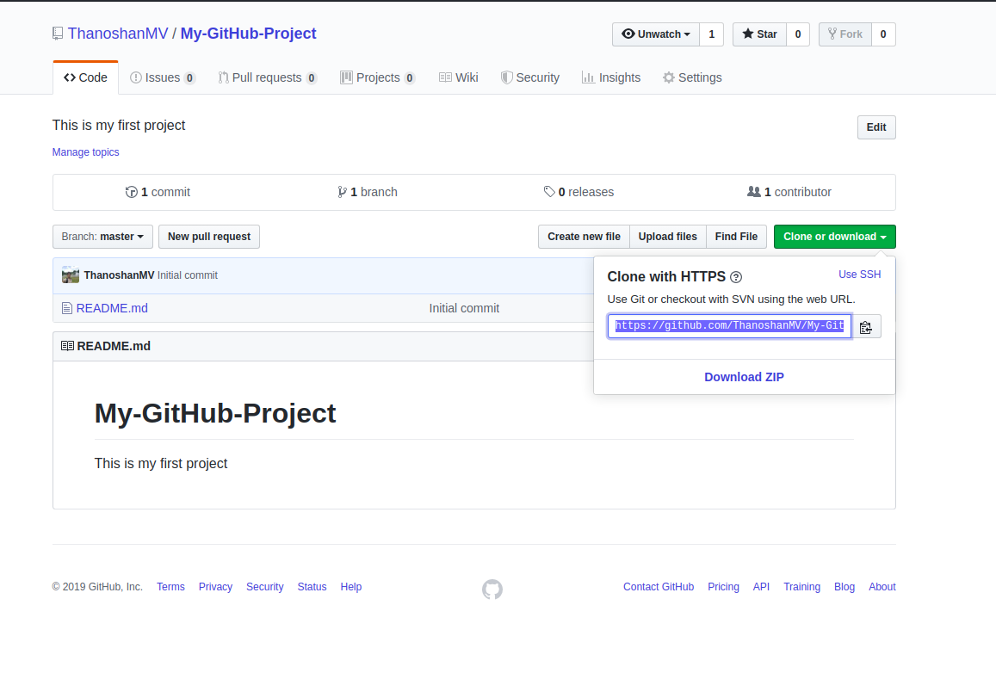

Well Done !
Your first GitHub repository
is created.
Notes:
Well done! Your first GitHub repository is created.
Your first mission is to get a copy of the repository on your computer. To do that, you need to “clone” the repository on your computer.
To clone a repository means that you're taking a repository that’s on the server and cloning it to your computer – just like downloading it. On the repository page, you need to get the “HTTPS” address.

Slide 15
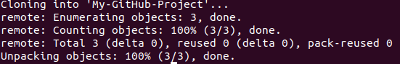
git clone [HTTPS ADDRESS]
Notes:
Once you have the address of the repository, you need to use your terminal. Use the following command on your terminal. When you’re ready you can enter this: git clone [HTTPS ADDRESS]
This command will make a local copy of the repository hosted at the given address. Output message of “git clone” command

Slide 16
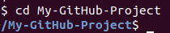
cd [NAME OF REPOSITORY]
Notes:
Now, your repository is on your computer. You need to move in it with the following command. As you can see in the above picture, my repository name is “My-GitHub-Project” and this command made me go to that specific directory. When you clone, Git will create a repository on your computer. If you want, you can access your project with the computer user interface instead using the above ‘cd’ command on the terminal.
Now, in that folder we can create files, work on them, and save them locally. To save them in a remote place — like GitHub – we have do a process called a “commit”. To do this, get back to your terminal. If you closed it, like I previously stated, use the ‘cd’ command.

Slide 17
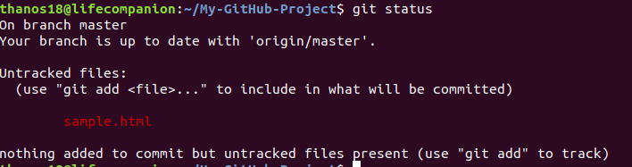
“status”: The first thing you need to do is to check the files you have modified. To do this, you can type the following command to make a list of changes appear. git status
Notes:
Now, in the terminal, you’re in your repository directory. There are 4 steps in a commit: ‘status’ , ‘add’ , ‘commit’ and ‘push’. All the following steps must be performed within your project. Let's go through them one by one.

Slide 18
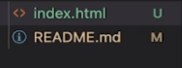
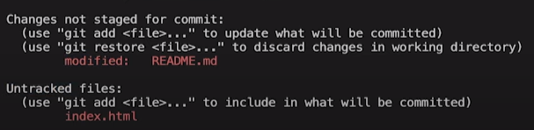
Untracked File
Modified File

Slide 19

Changes (modified)
New File (Untracked)
git add (Staged)
, Then Commit

Slide 20
“add”: With the help of the change list, you can add all files you want to upload with the following command,
git add [FILENAME] [FILENAME] [...]
In our case, we’ll add a simple HTML file.
git add sample.html
Notes:
Now, in the terminal, you’re in your repository directory. There are 4 steps in a commit: ‘status’ , ‘add’ , ‘commit’ and ‘push’. All the following steps must be performed within your project. Let's go through them one by one.

Slide 21
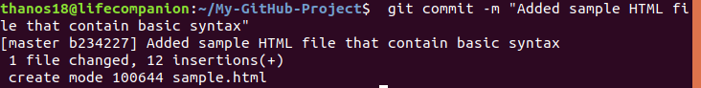
“commit”: Now that we have added the files of our choice, we need to write a message to explain what we have done. This message may be useful later if we want to check the change history. Here is an example of what we can put in our case.
git commit -m "Added sample HTML file that contain basic syntax"

Slide 22
“push”: Now we can put our work on GitHub. To do that we have to ‘push’ our files to Remote. Remote is a duplicate instance of our repository that lives somewhere else on a remote server.
git remote
Notes:
To do this, we must know the remote’s name (Mostly remote is named origin). To figure out that name, type the following command. As you can see in the above image, it says that our remote’s name is origin. Now we can safely ‘push’ our work by the following command.

Slide 23

git push origin main
git push –u origin main

Slide 24
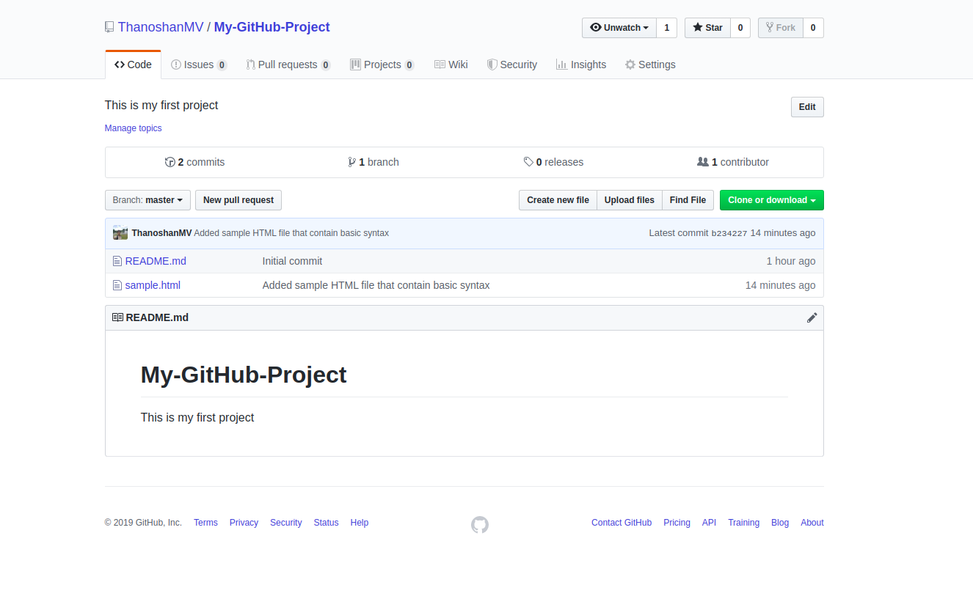
Notes:
Now, if we go to our repository on the GitHub web page, we can see the sample.html file that we’ve pushed to remote — GitHub!

Slide 25
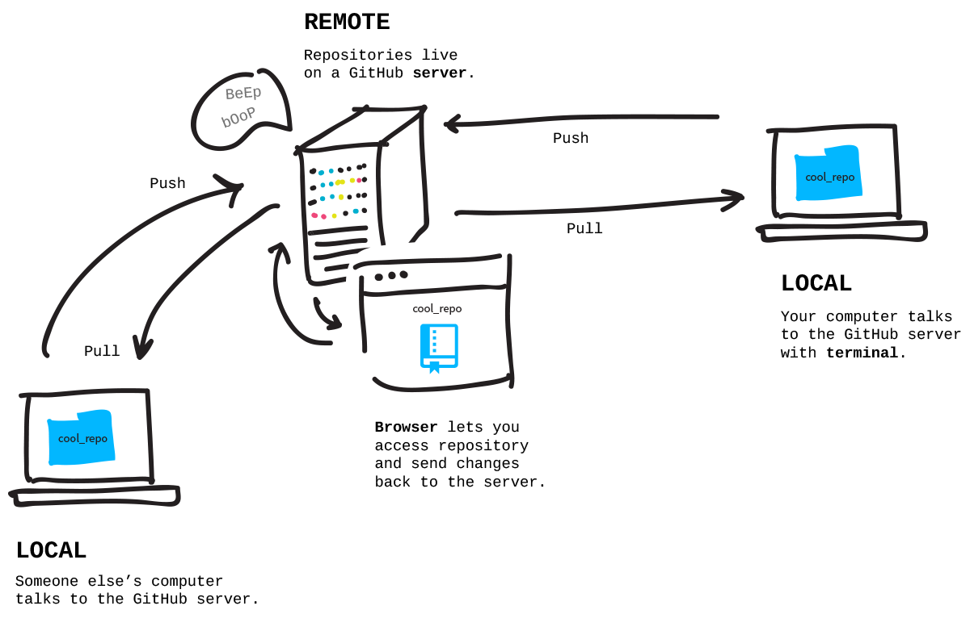
Notes:
Pulling is the act of receiving from GitHub.
Pushing is the act of sending to GitHub.

Slide 26
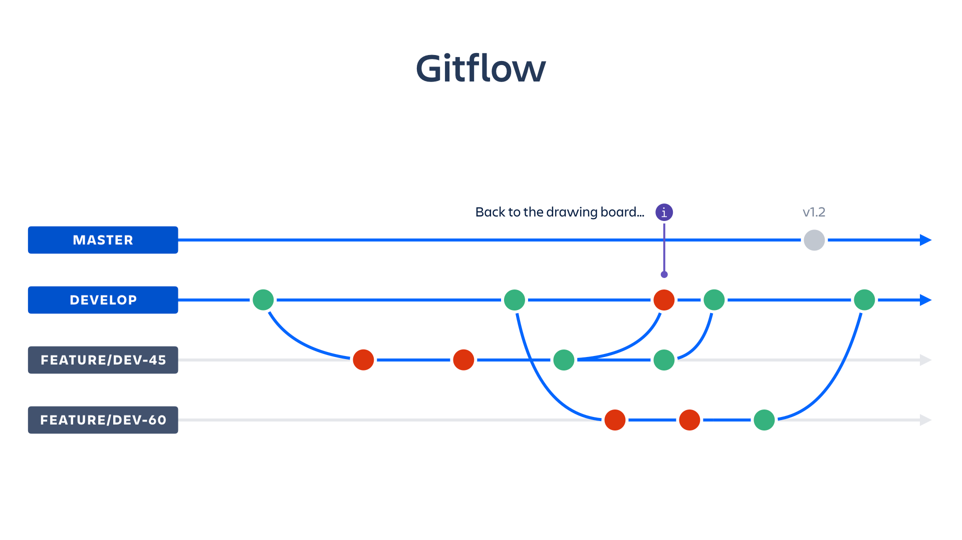

Slide 27
Branch Commands
git branch (to check branch)
git branch –M main (to rename branch)
git checkout <-branch name -> (to navigate)
git checkout –b <-new branch name -> ( to create new branch )
git branch –d <- branch name -> (to delete branch)

Slide 28
Merging Commands
1 way
git diff <-branch name -> (to compare branch, name ,files etc )
git merge <-branch name -> (to merge 2 branches )
2 way
Create a PR
Notes:
The terminology used to merge a branch with an official repository is a 'pull request'. This is confusing, as it appears that I am requesting to push my changes to the official repository.
Why is it called a pull request and not a push request?
If you have a code change in your repository, and want to move it to a target repository, then:
"Push" is you forcing the changes being present in the target repository (git push).
"Pull" is the target repository grabbing your changes to be present there (git pull from the other repo).
A "pull request" is you requesting the target repository to please grab your changes.
A "push request" would be the target repository requesting you to push your changes.

Slide 29

Collaborating
Notes:
Collaborating:
So imagine you and your friend are collaborating on a project. You both are working on the same project files. Each time you make some changes and push it into the master repo, your friend has to pull the changes that you pushed into the git repo. Meaning to make sure you’re working on the latest version of the git repo each time you start working, a git pull command is the way to go.

Slide 30
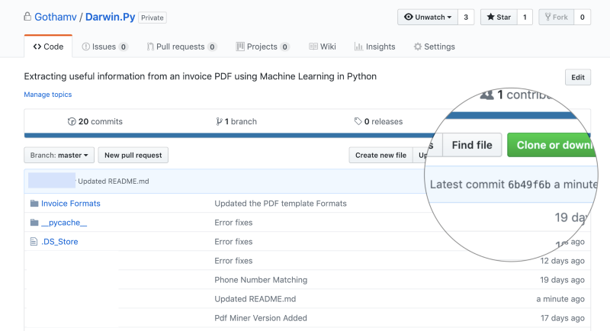
Now below is an example of a project my friend and I are collaborating on:
$ git pull origin main
Notes:
So to make sure those changes are reflected on my local copy of the repo:

Slide 31
$ git fetch AND $ git merge
When you use git pull, Git tries to automatically do your work for you.
When you git fetch, Git gathers any commits from the target branch that do not exist in your current branch and stores them in your local repository.
Notes:
Here’s two more useful git commands:
$ git fetch AND $ git merge
In the simplest terms, git fetch followed by a git merge equals a git pull. But then why do these exist?
When you use git pull, Git tries to automatically do your work for you. It is context sensitive, so Git will merge any pulled commits into the branch you are currently working in. git pull automatically merges the commits without letting you review them first.
When you git fetch, Git gathers any commits from the target branch that do not exist in your current branch and stores them in your local repository. However, it does not merge them with your current branch. This is particularly useful if you need to keep your repository up to date, but are working on something that might break if you update your files. To integrate the commits into your master branch, you use git merge.

Slide 32

Resolving Merge Conflicts
An Event that takes places where git is unable to automatically resolve the differences in code
between two commits.

Slide 33


Undoing Changes
Case 1 : staged changes (add)
git reset <-filename -> (single file)
git reset (Multiple file) Case 2 : committed Changes (for one commit )
git reset HEAD ~1
Previous one
Latest
1
2
3
4
Head
Head

Slide 34

Undoing Changes
Case 3 : committed Changes (for many commit )
git reset <-commit hash -> git log ( to get hash ) git reset --hard <-commit hash ->
Hash eg : c71fb8fe43281f092f6c30e409bf94fd138a20d4
Latest
1
2
3
4
Head
Head

Slide 35
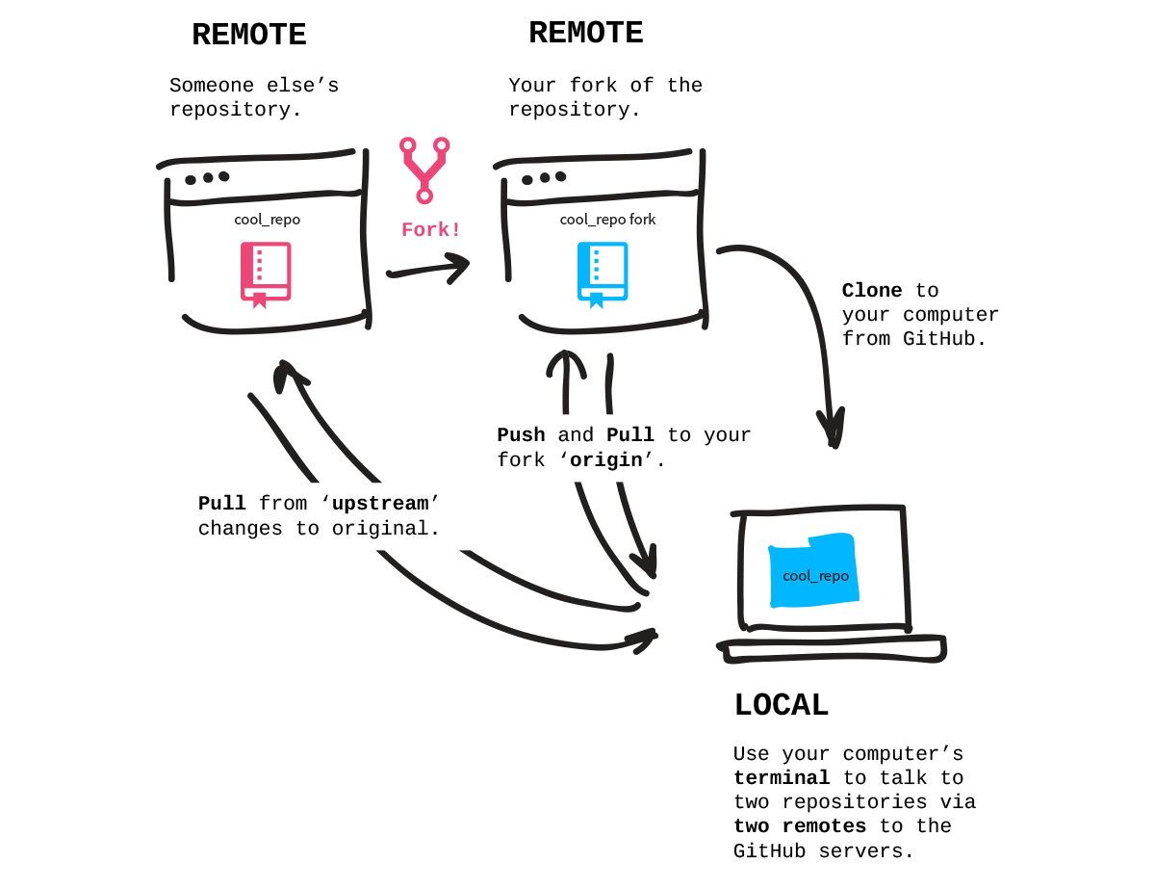
Forking
Notes:
Suppose you love working on a particular framework or library like React.js. One fine day, you figure out a way that you can enhance the functionality of React yourself.
React's source code is available as a public repository on GitHub, so you can make a local copy of it by forking it.
Once you get the local copy of the code, you can make the relevant changes and ask the React community to review your changes.
After reviewing your code changes, the React community may approve them or ask you for more changes. They are most likely to take your code changes after approval.

Slide 36

Notes:
To follow along, browse to a public repository that you want to fork. At the top right of the page, you will find the Fork button. Click on the button and wait for a few seconds. You will see that the newly forked repository gets created under your GitHub account.

Slide 37
Let's Practice Forking
Browse to this public repository: https://github.com/atapas/fork-me
Notes:
Let's Practice Forking
As a newbie, do you want to practice forking to be more confident? Let's do that. You can perform these tasks to practice forking.
Browse to this public repository: https://github.com/atapas/fork-me
Create a folder with the same name as your GitHub user-id (it is atapas for me).
Add a Readme.md file inside the folder with any text of your choice.
Create a Pull Request upstream. I shall review and merge it if all is well.

Slide 38

Git Checkout
Git documentation.
Notes:
The git checkout command switches between branches or restores working tree files. There are a number of different options for this command that won’t be covered here, but you can take a look at all of them in the Git documentation.

Slide 39
Checkout a specific commit
to checkout a specific commit, run the command :
git checkout specific-commit-id
we can get the specific commit id’s by running:
git log
Checkout an Existing Branch
To checkout an existing branch, run the command:
git checkout BRANCH-NAME

Slide 40
Checkout a New Branch
To create and checkout out a new branch with a single command, you can use:
git checkout -b NEW-BRANCH-NAME
we can get the specific commit id’s by running:
git log
Checkout an Existing Branch
To checkout an existing branch, run the command:
git checkout BRANCH-NAME
Notes:
Checkout a New Branch
To create and checkout out a new branch with a single command, you can use: git checkout -b NEW-BRANCH-NAME
This will automatically switch you to the new branch.

Slide 41



Git Storage Service Providers

Slide 42
Issues

Slide 43
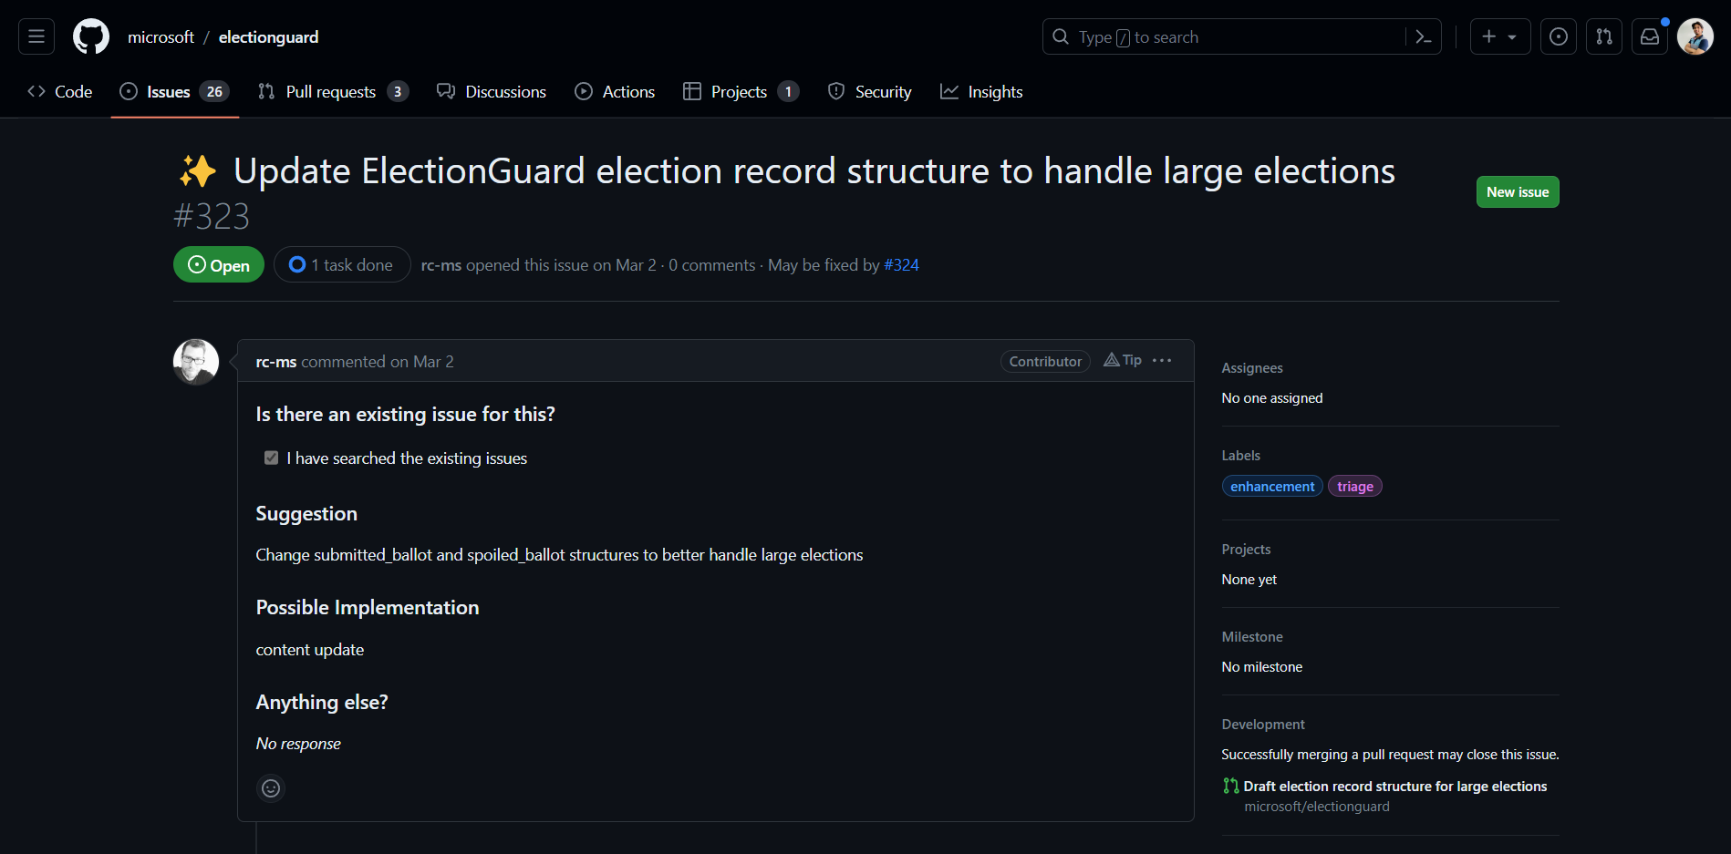
Issue Created

Slide 44
Pull Request

Slide 45
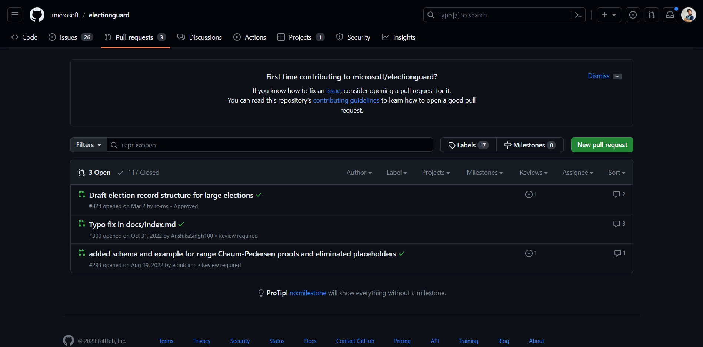
Pull Request

Slide 46
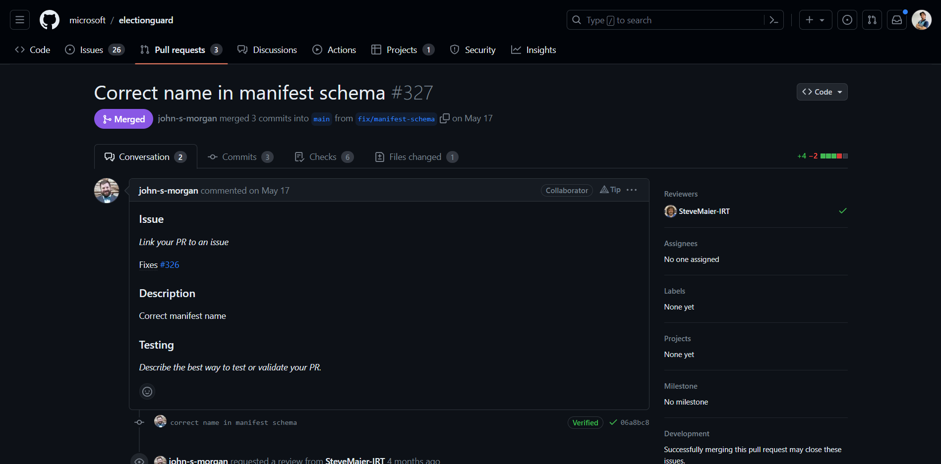
Successfully Merged

Slide 47
Code Review

Slide 48
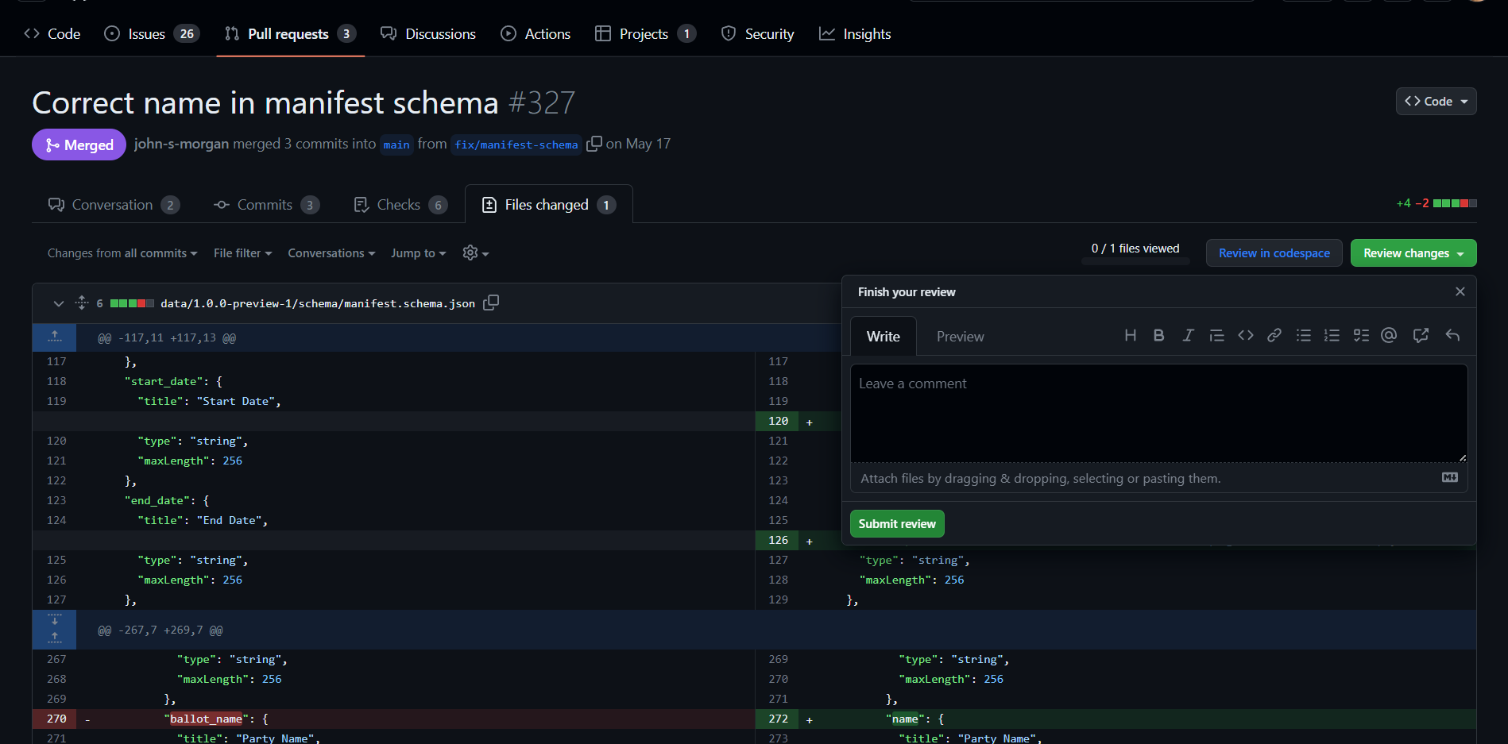
Code Review

Slide 49
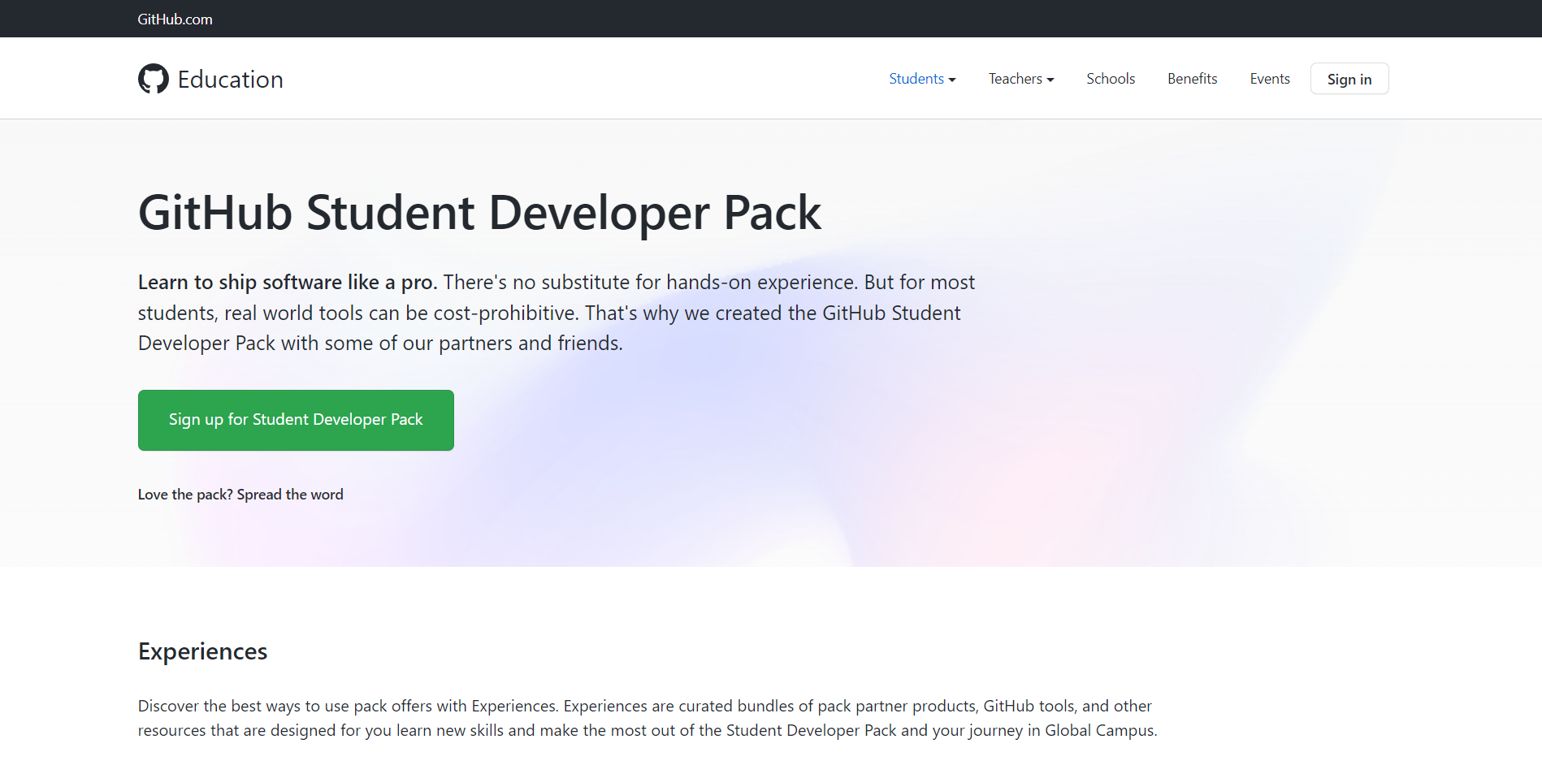


Slide 50
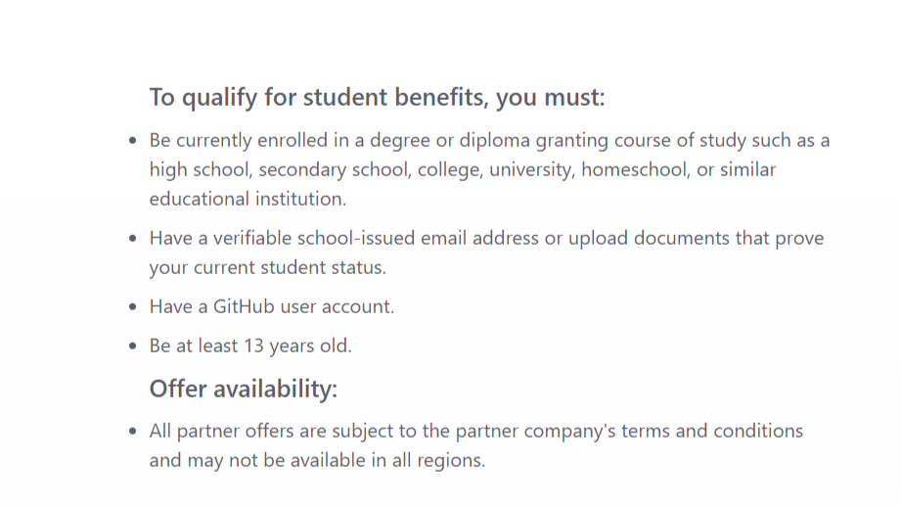

Slide 51
Thank you for attending Q&A

Slide 52


What is Git?
ⓘ Start presenting to display the poll results on this slide.

Slide 53
What is the command to get all the change history of the remote repository "origin"?
ⓘ Start presenting to display the poll results on this slide.

Slide 54
Which Command is used to show limited number of commits?
ⓘ Start presenting to display the poll results on this slide.

Slide 55
How do you create a new branch in Git?
ⓘ Start presenting to display the poll results on this slide.

Slide 56
.......... is equivalent to fetch and merge
ⓘ Start presenting to display the poll results on this slide.

Slide 57
You are working on a project and you have made some changes that you want to discard, but you haven’t committed them yet. What command should you use?
ⓘ Start presenting to display the poll results on this slide.

Slide 58
Git automatically adds new files to the repository and starts tracking them.
ⓘ Start presenting to display the poll results on this slide.

Slide 59
What is the command to commit with the message "New email":
ⓘ Start presenting to display the poll results on this slide.

Slide 60
We have just created a new file called “home.html”. Which of the following will add this file so that we can commit it in git?
ⓘ Start presenting to display the poll results on this slide.

Slide 61
Which of the following commands used to return to the master branch?
ⓘ Start presenting to display the poll results on this slide.

Slide 62
Which one of these statements about a merge involving a merge commit is true?
ⓘ Start presenting to display the poll results on this slide.

Slide 63
Which one of these statements about Git is true?
ⓘ Start presenting to display the poll results on this slide.

Slide 64
You are working on a project with a team and you have made some changes to the code in your local repository. You want to push your changes to the remote repository, but you realize that someone else has already pushed their changes. Avoid that conflict?
ⓘ Start presenting to display the poll results on this slide.

Slide 65
Which location contains the commit history of a project?
ⓘ Start presenting to display the poll results on this slide.

Slide 66
What is a pull request?
ⓘ Start presenting to display the poll results on this slide.

Slide 67
When can you open a pull request?
ⓘ Start presenting to display the poll results on this slide.

Slide 68
After forking a repository, which one of these statements is true?
ⓘ Start presenting to display the poll results on this slide.

Slide 69
Which command creates an empty Git repository in the specified directory?
ⓘ Start presenting to display the poll results on this slide.

Slide 70
Which of the following command line environment is used for interacting with Git ?
ⓘ Start presenting to display the poll results on this slide.

Slide 71
Which is true ?
ⓘ Start presenting to display the poll results on this slide.

